Slide 2

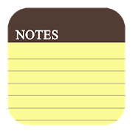
Learning objectives
In this lesson you will learn to:
  use relational operators in flowcharts and code
  use ‘if…elif…else’ in code
  identify comments, whitespace, meaningful identifiers, and indentation in code.
For more information on this topic, and additional student activities, see Topic 1.4 of the student book.
© Pearson Education Ltd 2020. Copying permitted for purchasing institution only.
Notes:
Specification content: 1.2.1 1.2.2 1.2.3 6.1.3 6.2.1 6.2.2, 6.5.2

Slide 3
Selection
Previously, you looked at selection.
This meant choosing a path through a program based on a condition.
Weather == “rain”?
No
Yes
Output “take an umbrella”
Output “no need for the umbrella today”
© Pearson Education Ltd 2020. Copying permitted for purchasing institution only.

Slide 4
Selection
But what if you want to examine a variable that could have many different values? For example, the colour of a car could be red, blue, black, or white.
To find out what the colour is you would have to ask more questions.
Remember that in a flowchart, the decision symbol can only contain a question with a ‘yes’ or ‘no’ answer.
If you want to examine a variable that could have more than one value - you need to ask more ‘yes’ or ‘no’ questions.
Let’s look at an example.
© Pearson Education Ltd 2020. Copying permitted for purchasing institution only.

Slide 5
String indexing
Start
userAge = user input
Here is a simple algorithm.
Let’s run through it together and see how it works.
userAge < 16?
Yes
Output “you cannot drive”
No
userAge < 18?
Yes
Output “you could drive a moped”
No
Output “you could drive a car”
End
© Pearson Education Ltd 2020. Copying permitted for purchasing institution only.
Notes:
Student Activity 1

Slide 6
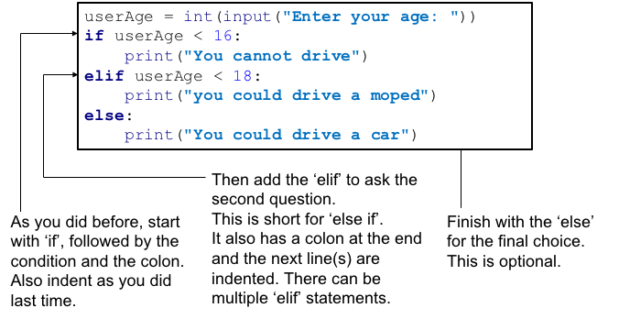
String slices
Let’s translate the example flowchart into Python:
© Pearson Education Ltd 2020. Copying permitted for purchasing institution only.
Notes:
Student Activities 2 and 3

Slide 7
Variables and constants
Up to now you have been using variables in your programs to store values that can be changed while the program is running.
There are times when programmers don’t want a value to change.
Can you think of any examples of values that need to stay unchanged?
When you want to use a value that you don’t want to change, use a constant.
This is a stored value, like a variable, but it will not be changed while the program is running.
Constants are useful tools for a programmer, particularly one who is working on someone else’s code.
© Pearson Education Ltd 2020. Copying permitted for purchasing institution only.
Notes:
Pi, gravity, VAT

Slide 8
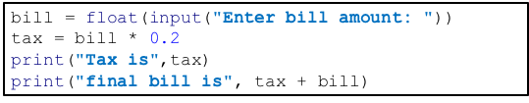
Constants
Let’s look at a simple example to see why constants are so useful.
What does the 0.2 value mean? It could be anything!
© Pearson Education Ltd 2020. Copying permitted for purchasing institution only.

Slide 9
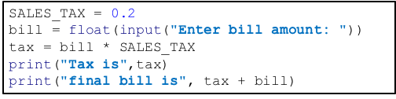
Constants
This version is easy to read - the 0.2 is the sales tax applied to the bill.
If the sales tax rate changes - only needs to be changed in one single place.
© Pearson Education Ltd 2020. Copying permitted for purchasing institution only.

Slide 10
Constants
There are a few guidelines about how you should use constants.
In some programming languages constants are strictly enforced. Python does not have such strict rules built in, so you need to be clear about the difference between a constant and a variable.
SALES_TAX = 0.2
Constants should be named using all capital letters, with words separated by an underscore. This makes them stand out from variables.
Constants should be declared (created) at the start of a program.
Constants should be given a sensible, useful name – just like all variables.
© Pearson Education Ltd 2020. Copying permitted for purchasing institution only.
Notes:
Student Activity 4

Slide 11
Writing maintainable code
As you develop more code over time, you may find that when you go back to your old code it is difficult to understand. There are a few things you can do as a programmer to help yourself (and others) work with your code in the future.
One of these is to use meaningful names for variables and constants, which you should already be doing.
Another is laying out your code in a particular order and using comments to add information.
We’ll look at an example of how you can do this now.
© Pearson Education Ltd 2020. Copying permitted for purchasing institution only.

Slide 12
# ------------------------------------------------------------
# Constants
# ------------------------------------------------------------
SALES_TAX = 0.2 #20%
# ------------------------------------------------------------
# Global variables
# ------------------------------------------------------------
bill = 0.0
tax = 0.0
# ------------------------------------------------------------
# Main program
# ------------------------------------------------------------
bill = float(input("Enter bill amount: "))
tax = bill * SALES_TAX
print("Tax is",tax)
print("final bill is", tax + bill)
Writing maintainable code
# is a comment. Ignored by the programming language, but give extra information.
Blank lines. These aid readability. They are called whitespace.
Order: Constants declared first, then variables then the main program.
Lines of dashes - it will make your programs much easier to read.
© Pearson Education Ltd 2020. Copying permitted for purchasing institution only.
Notes:
Student Activity 5

Slide 13

Drawing a Flowchart
Look at the size of the flowchart – does it need to go on a complete page?
Use a ruler and a sharp pencil at all times.
Make sure that the shapes are clear and distinct from one another
© Pearson Education Ltd 2020. Copying permitted for purchasing institution only.

Slide 14
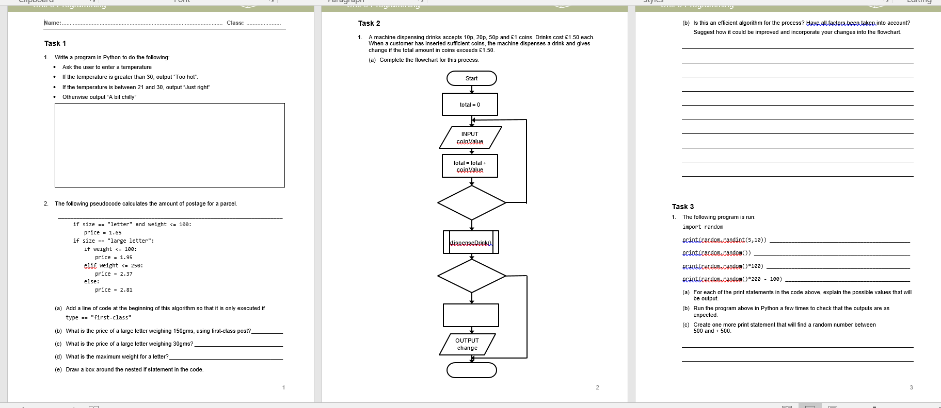
Activity Worksheet make sure that you have written enough of the task so that the answer makes sense in your books.
© Pearson Education Ltd 2020. Copying permitted for purchasing institution only.

Slide 15
Wrap up, you have learned how to . . .
Use relational operators in flowcharts and code.
      == < > <= >= !=
Use ‘if…elif…else' in code.
  This structure allows you to add multiple conditions to one variable.
Identify comments, whitespace, meaningful identifiers, and indentation in code.
  These are good habits for programmers to get into. They enhance the readability of code.
© Pearson Education Ltd 2020. Copying permitted for purchasing institution only.

